Slide 1
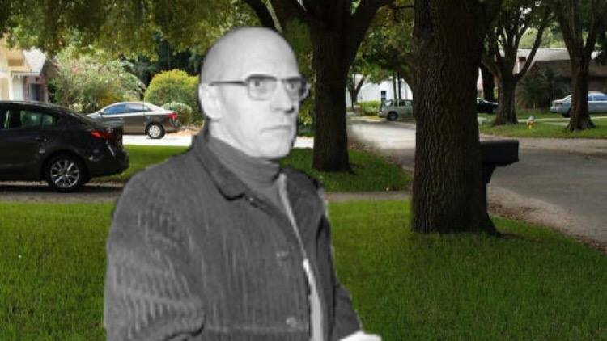
Memes, postmodernism, and you
jackie champagne
27 september 2019
gsps

Slide 2
what is a meme? Where did it come from, where did it go?

Slide 3
What is a meme?: memes as anthropology
$μιμημα$: an imitated thing
The Selfish Gene (1976), Richard Dawkins
A meme is the cultural analog to a gene – a transmittable unit of culture that is recognized, copied, shared and modified among humans

Slide 4
What is a meme?: memes as internet subculture
Godwin’s law (1990):
Mike Godwin (UT ‘90 alum and editor of the Daily Texan!) coined “internet meme” in a 1993 Wired article, describing the viral images and videos shared on forums like Usenet or forwarded through email

Slide 5
What is a meme?: origins
Early memes predominantly shared on:
forum-type sites (Usenet, reddit, 4chan)
Pre-YouTube content creator sites (ebaumsworld, albinoblacksheep)
Classical memes shared on personal social media sites:
Facebook, Tumblr, still some Reddit origins
Postmodern memes come from mixed media:
Still personal accounts → text memes on Twitter, images on Instagram, TikTok/Vine
Rise of anonymous accounts → meme Instagram accounts, Twitter bots, finstagram/fwitter

Slide 6
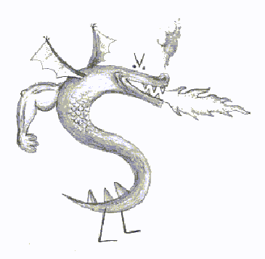
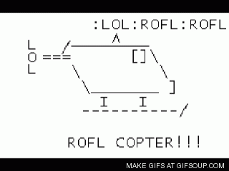
Progenitors to the modern meme
ASCII memes
L337: 1f u d0n’t kn0 wut im t4lkin abt, u r teh suck. I pwn u n00b!!!1
Chain-mail videos
Dancing baby (1996)
Hampster dance (1997)
The first image macros
IT’S A TRAP! (2001)

Slide 7
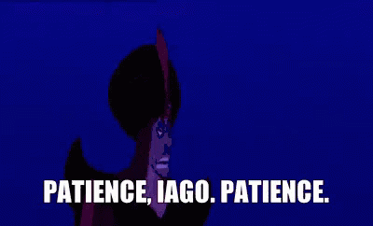
Pause.
“Jackie, you are Gen-Z-adjacent. Please tell me what Vine and TikTok are.”
In my opinion, video memes follow a separate, parallel timeline to meme images, so we will discuss them separately.

Slide 8
the classical meme era (~2009-2013)

Slide 9
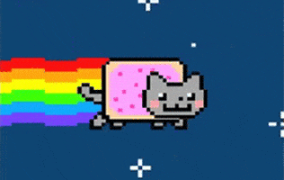

Slide 10
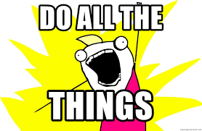
Memes as linguistic modifiers
Memes begin to warp our grammatical structure in a self-contained “meme slang” dialect.

Slide 11
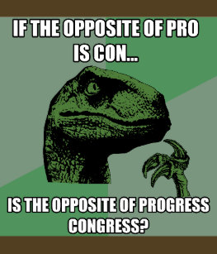
Advice animals

Slide 12
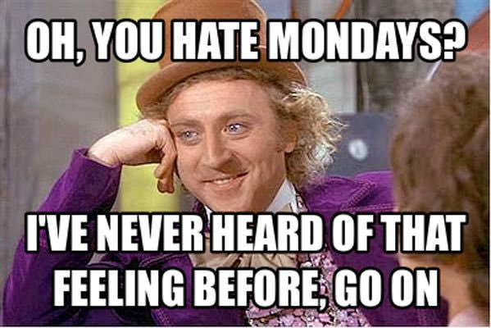
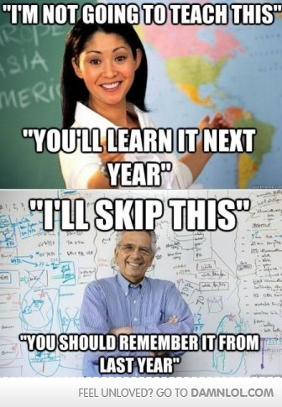
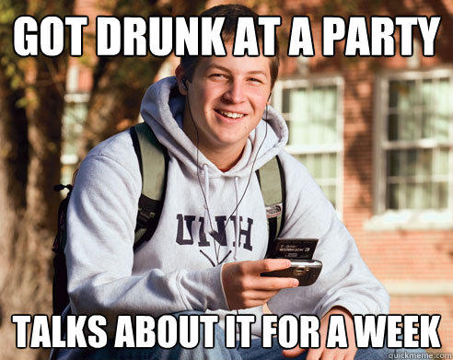
the faces of early memes

Slide 13
The classical meme formula
Impact font
Cause + effect punchline
→ top text = scenario setup
bottom text = scenario outcome
Image = reaction face
Recognizable facial expression

Slide 14
Image macro era
The most successful memes were not overly wordy nor did they contain complicated images. They were designed to be read and understood in less than a second. The most iconic element of the meme was the image itself: every punchline followed the same structure given the title of that meme. The punchlines almost always featured universal, relatable experiences.
Example: Bad Luck Brian would always contain top text: an everyday scenario, bottom text: the worst luck one could have with that experience.
Classical memes were easily replicable and imitatable.

Slide 15
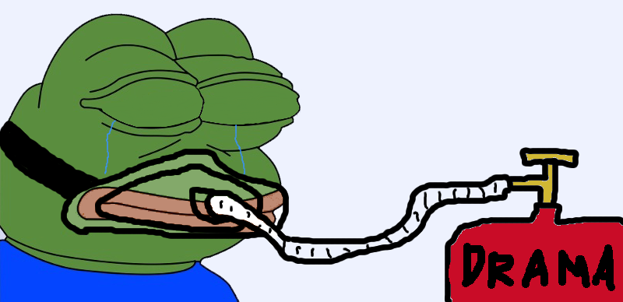
The sordid history of Pepe the frog
We will get to memes as political commentary in a little bit…
Pepe was a comics character created by Matt Furie in 2005; became a meme on 4chan, MySpace, and Gaia Online in 2008
He’s just an emotional frog
But starting in ~2016, Pepe became a symbol for alt-right politics and was featured in a number of racist and anti-Semitic memes, so Pepe was formally cancelled by the ADL
Pepe was resurrected as a symbol of resistance against police brutality in the Hong Kong protests of 2019
Notes:
Boys club

Slide 16
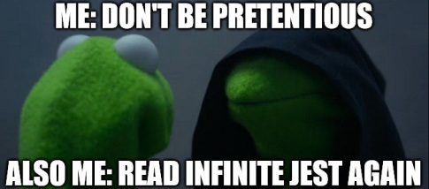
Kermit: the better frog
The Kermit Tea meme was created in 2014 on Instagram
Top text was typically a shady comment, but Kermit keeps his mouth shut and says it’s none of his business.
→ This is *not* the origin of the slang term “tea” – tea or T was used in Black drag culture to mean “truth” or “hot gossip”… but Kermit definitely helped it go mainstream
Led to many Kermit variants including Dark Kermit
Kermit sips on the truth tea.

Slide 17
The meme market
Dogecoin
A legitimate cryptocurrency launched in 2013 and was valued at $60 million within its first month
Rare pepes
Unique edits of Pepe the Frog could be exchanged like trading cards, leading to users “flooding the market” with Pepes
R/Memeconomy
Memes fluctuate in value and new memes can be invested in and traded

Slide 18
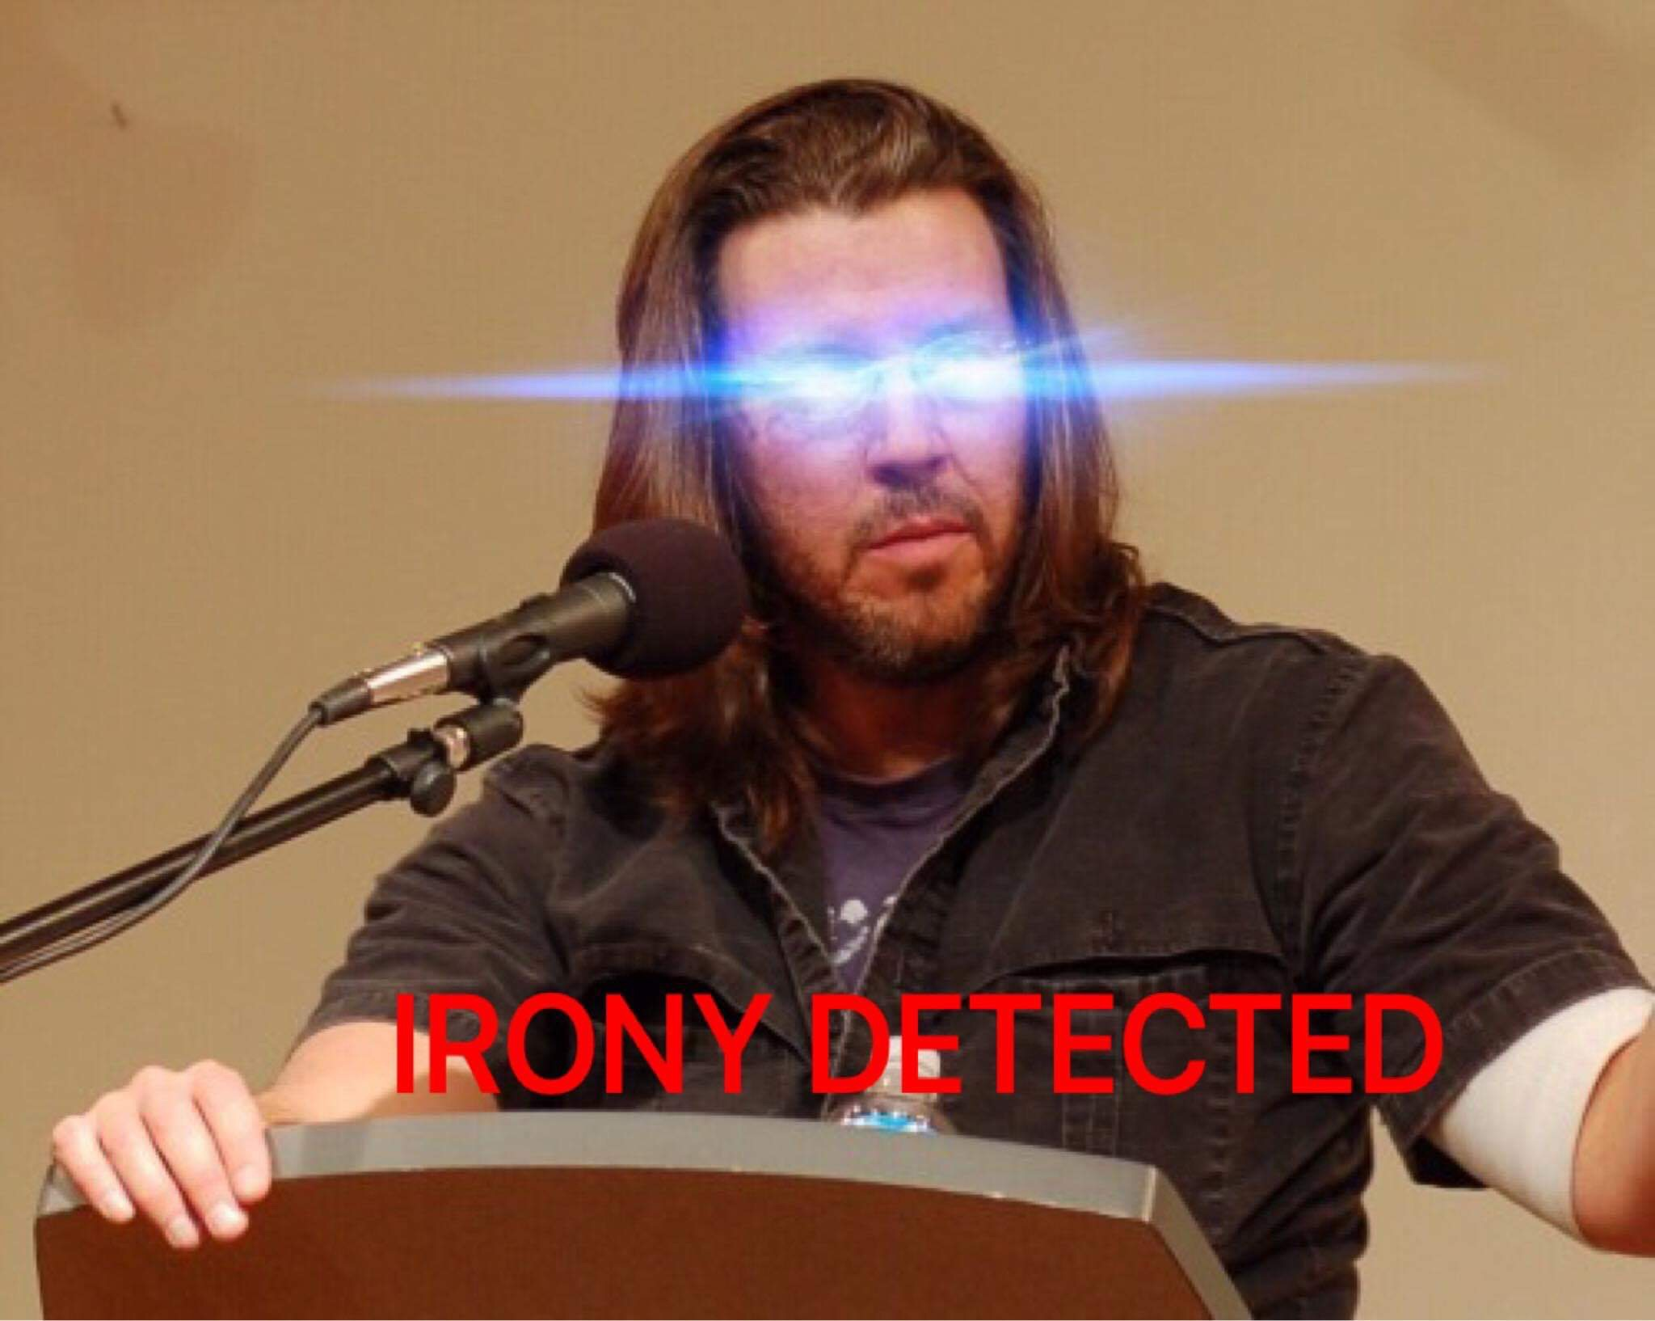
The postmodern era (2013-present?)

Slide 19
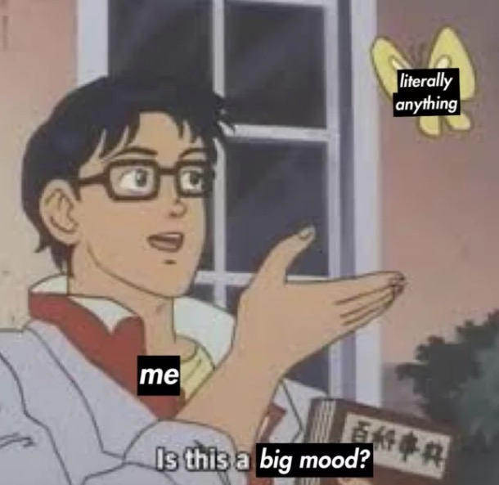
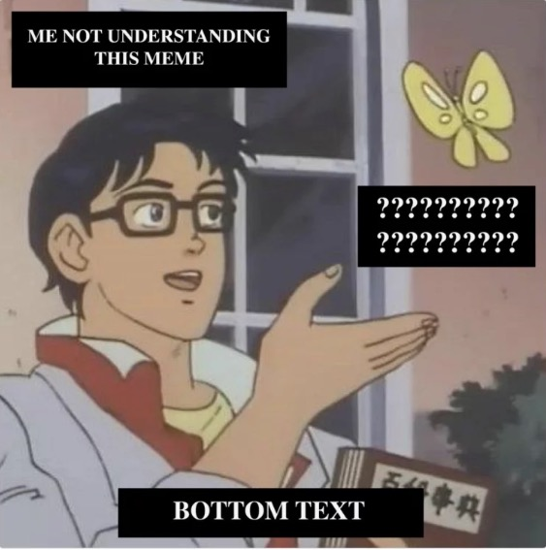
A new symbolic format
The new way to tell a joke is by labeling parts of an image which become self-referential symbols. This enables the user to construct a unique story in one or a few panels, so the image itself no longer carries any inherent meaning.

Slide 20
memes as pictographic references
In the postmodern meme, the punchline is no longer provided: it requires previous knowledge of its translation.
The picture of President Bush stands for “Bush did 9/11,” such that this poem reads:
Roses are red
Harambe’s in Heaven
Everyone knows Bush did 9/11

Slide 21
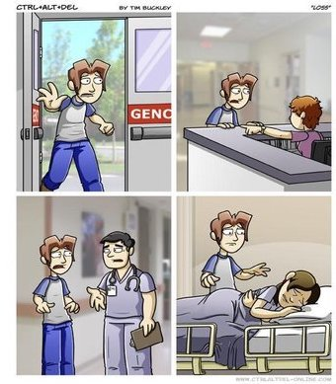
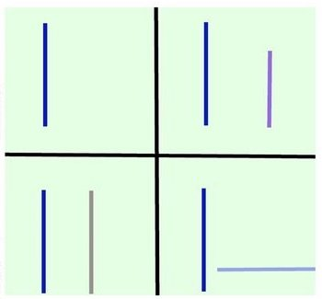
memes as pictographic references
Loss.jpg (pronounced loss dot jpeg) has a geometric structure: a 4 panel meme often hides the “loss shape.” You are typically given no warning of a loss.jpg meme so its goal is to induce frustration…

Slide 22
memes as pictographic references
This handsome young man represents the phrase, “You know I had to do it to em.” Typically used as a reaction image, but there was also a trend of hiding him in other images like Where’s Waldo.

Slide 23
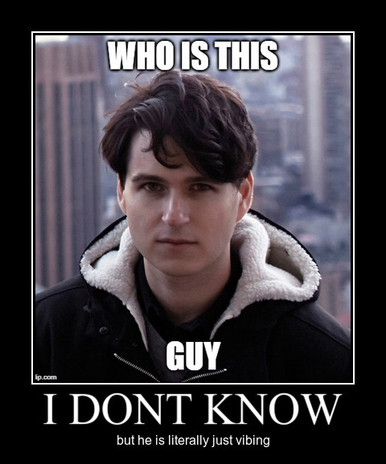
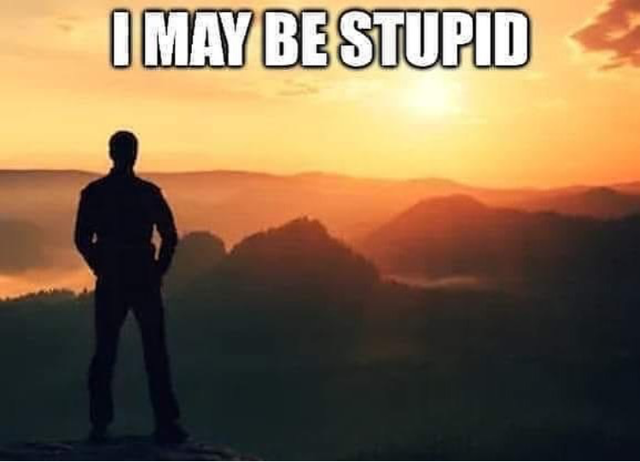
disrupting the form
Some postmodern memes make callbacks to the old meme formats: the inversion of structure forms an anti-joke.

Slide 24
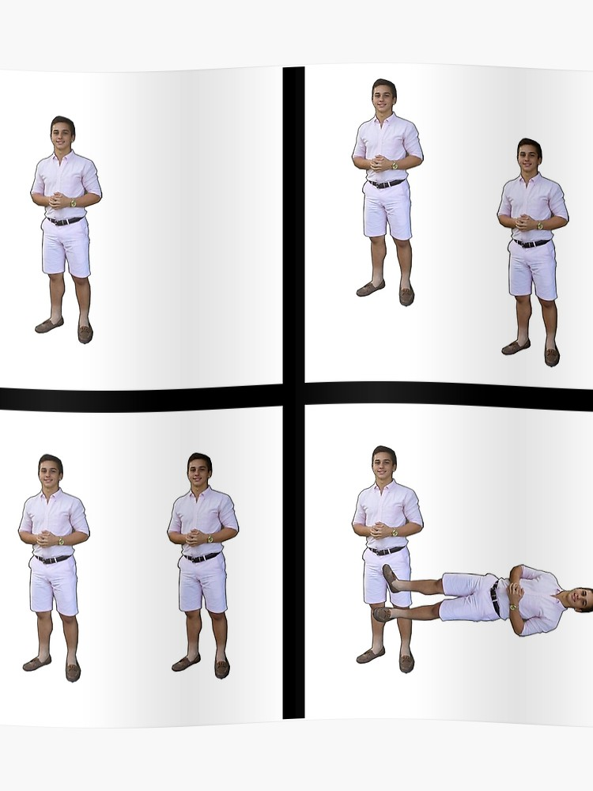

Slide 25
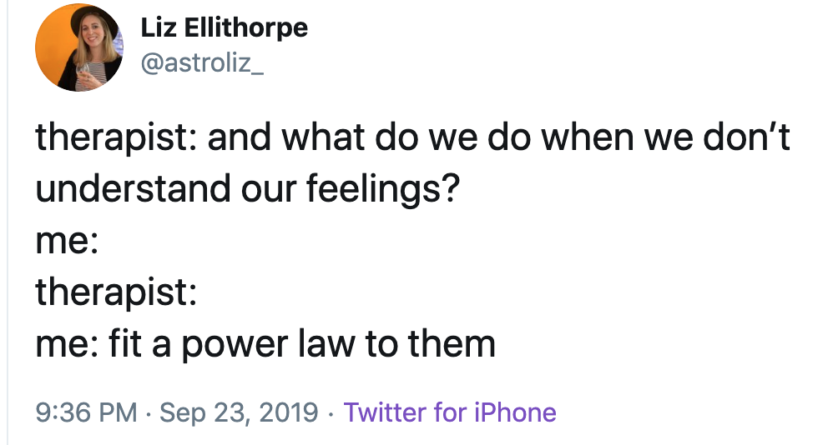
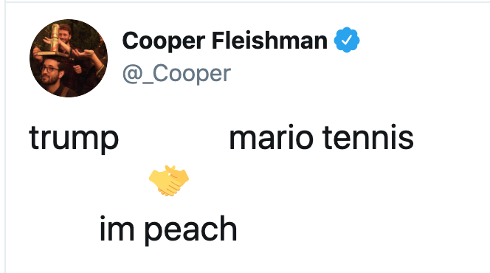
twitter memes
Meme phrases and ASCII formats stem mostly from viral tweets. Understanding of these memes sometimes requires an active social media presence because:
derivative memes will quickly bury the original joke
they’re often related to current events
I’d say they’re probably the shortest-lived memes

Slide 26
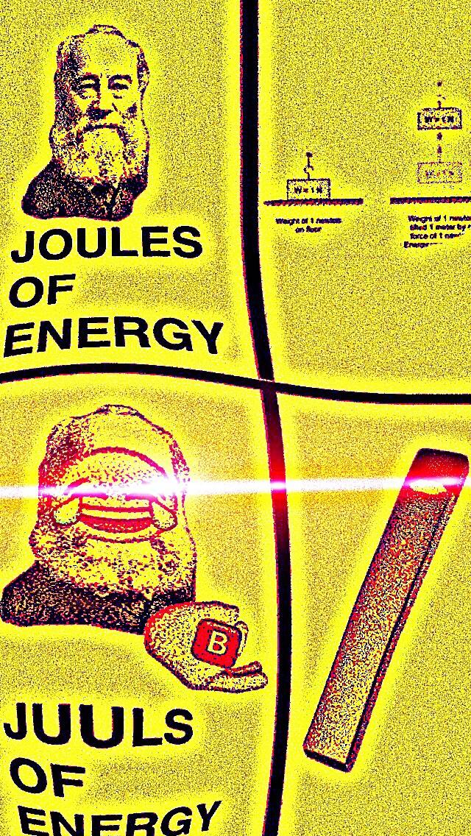
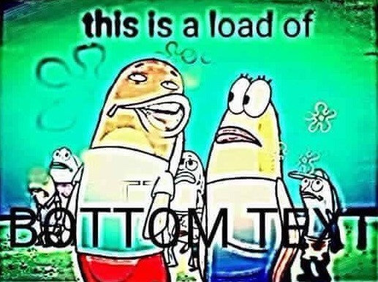
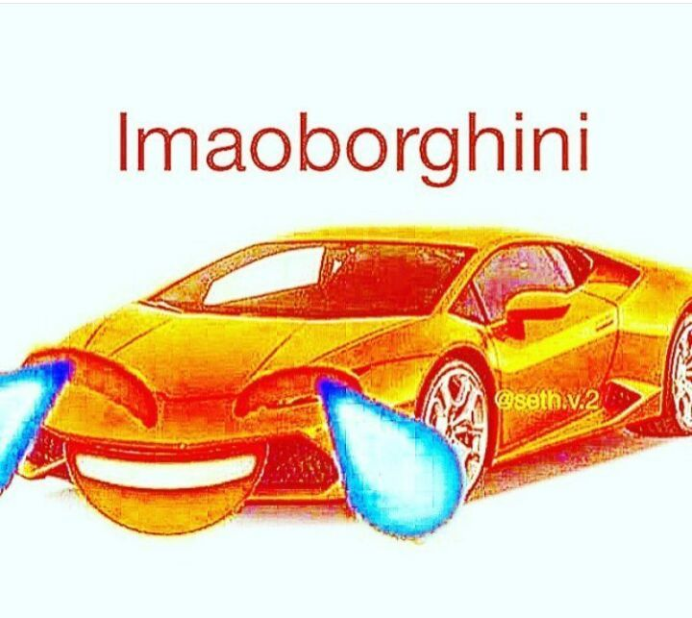
Deep-fried memes
Deep-fried memes involve running images through multiple editing filters until they are distorted or unrecognizable. They don’t really have a meaning – they’re like “late-night” memes.

Slide 27
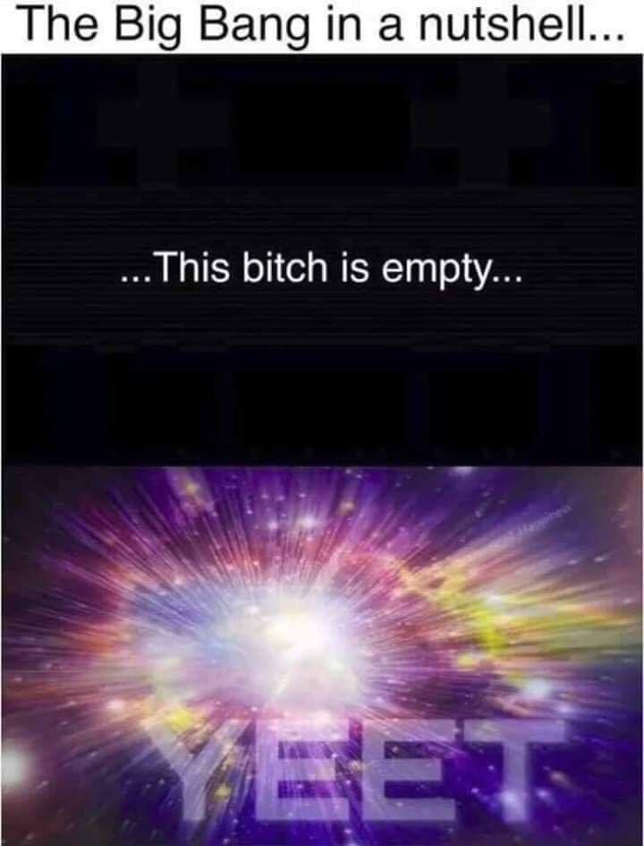
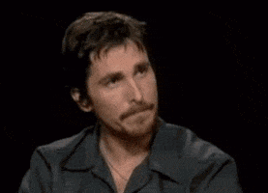
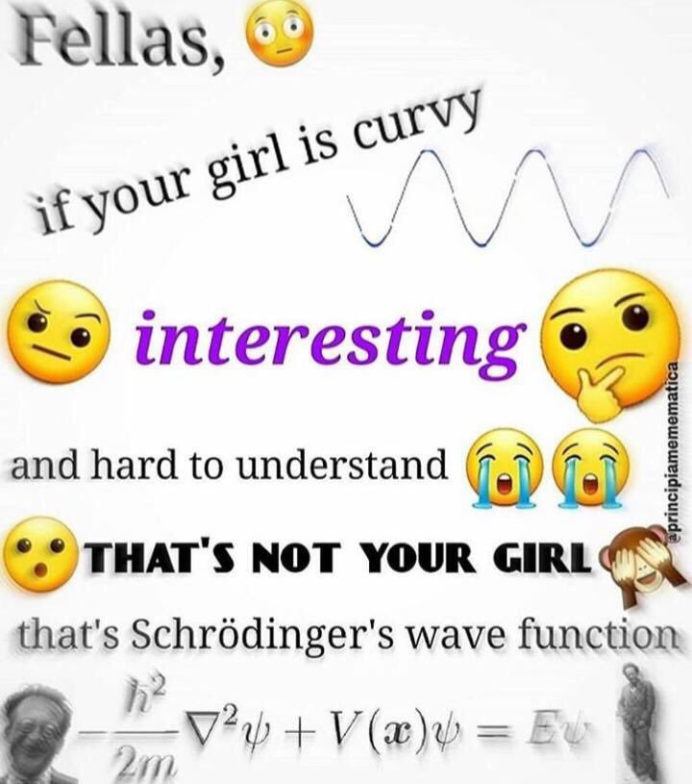
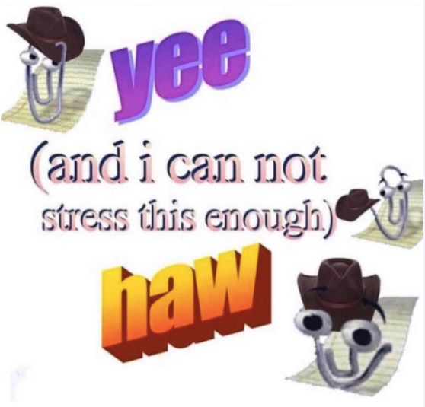
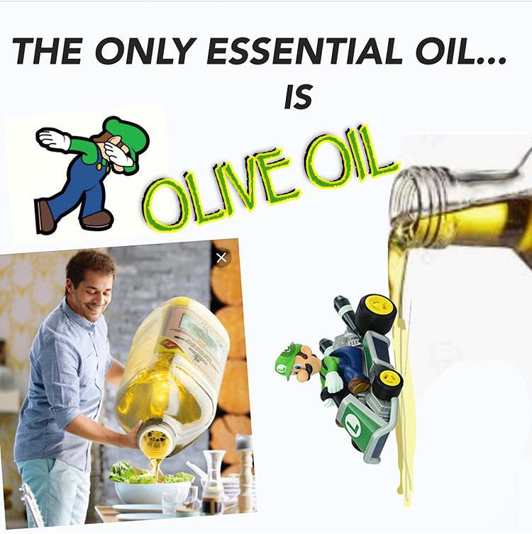
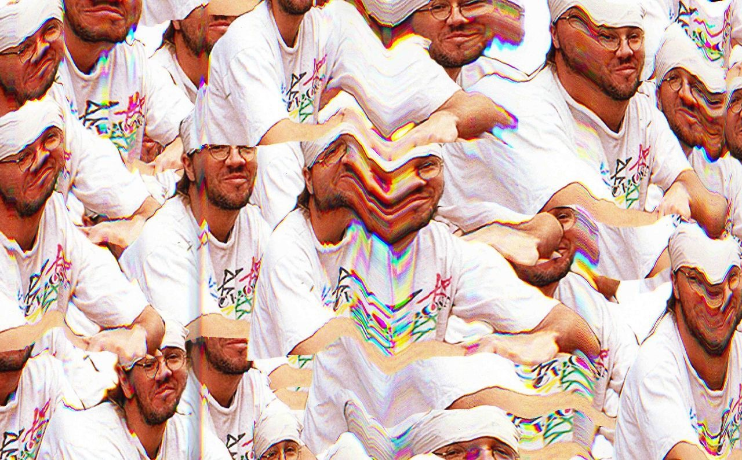
Dank/Surreal memes: postpostmodernism
It’s okay if these go too far for you. These memes are meant to be ironic parodies of the entire meme concept by purposely lacking any linear path to a punchline. They are meant to be taken at face-value. Imagine being so ironic that nothing is funny anymore.

Slide 28
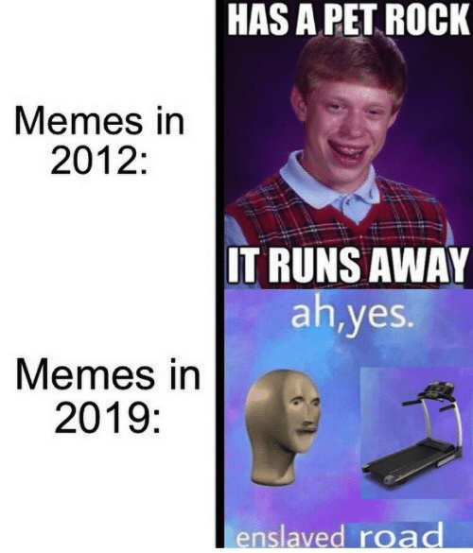
Let’s talk comparisons.

Slide 29
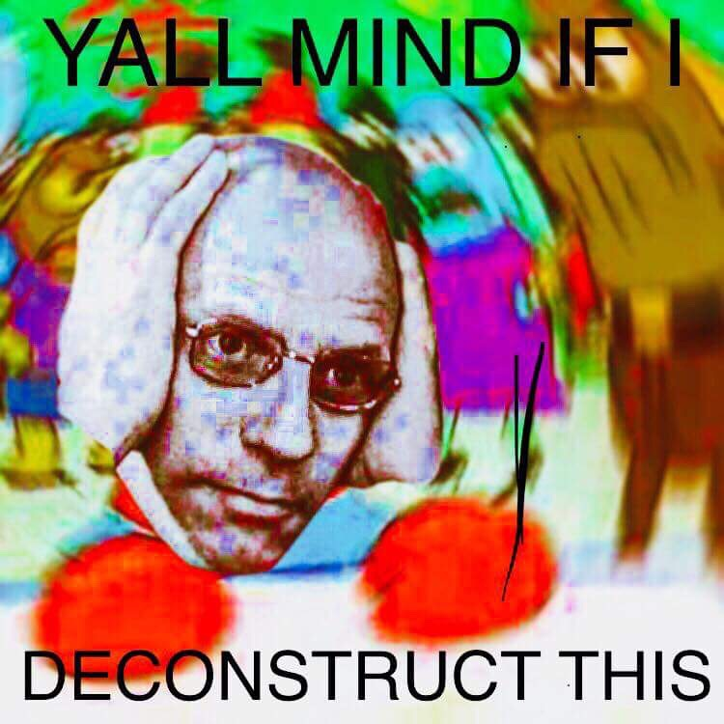
Key differences between meme eras
Formatting
Hyperspecific meaning
Reduced meme half-life

Slide 30
Key differences between meme eras
Formatting
Classical memes almost always included captions but they were linguistically simple and followed a cause and effect structure. The images were replicable and simple.
Postmodern memes can feature more complex images that require linguistic and visual interpretation from the reader. While the image itself is replicable, it is no longer the central focus of the meme.

Slide 31
Key differences between meme eras
Classical memes centered on generic, universal experiences. They contained brief one-liners or puns about everyday life and did not require outside knowledge to understand the punchline. They are self-contained.
Hyperspecific meaning
Postmodern memes typically refer to very specific experiences that may not be applicable to all readers. They often require knowledge of other memes or pop culture. Since the format focuses on symbolic images more than words, the reader is required either to fill in a story or to take the image at face value.

Slide 32
Key differences between meme eras
Reduced meme half-life

Slide 33
Key differences between meme eras
Because older meme formats offered ready-made punchlines, the images remained in circulation for several months to years.
Modern memes are typically popular for a few weeks at most. I have a few theories on this:
Memes are typically created on platforms with higher media consumption rates
Hyperspecific anti-punchlines coupled with irrelevant images means they can be changed out regularly
The availability of apps allowing people to create content makes it easier for more varied content to go viral more often
A helpful infographic on meme lifetimes
Reduced meme half-life

Slide 34
Vine killed the radio star

Slide 35
Viral videos
Viral videos be the same. Just more ridiculous.
Like static memes, the old viral videos made their way through AlbinoBlackSheep and Newgrounds. A lot of new ones come from YouTube.

Slide 36
The youtube poop (YTP) era (~2005-2011)
YTP involves editing previous video content (usually TV shows or video games) to create a bizarre, nonsense narrative. The sound is typically highly distorted, with dialogue randomly spliced to create new sentences or gibberish. Sometimes it’s auto-tuned. I don’t know.

Slide 37
The vine era
Video sharing app released in 2013
Allowed users to record and upload 7-second videos
Pioneering feature was the method of video recording that allowed for jump cuts and special effects
Spawned a new format of comedic storytelling → short punchlines + visual effects to symbolize character traits
Shut down in late 2016 and archive taken down in January 2017

Slide 38
Of course I have examples for you
911 what’s your emergency?
Road work ahead
wrOw
Look at this graph
YEET

Slide 39
Vine shutdown leads to youtube renaissance
While Vine was great for creating content, the app wasn’t particularly “consumer”-friendly
Its shutdown led to the vine compilation phase on YouTube, consisting of 10+ minute collections of Vines
Many popular Vine content creators went on to create comedy channels on YouTube and now they go on tour and stuff??
Notes:
there was no way to save a collection of Vines you liked (as on Twitter or Tumblr)
Having only 7 seconds wasn’t worth the time it took to scroll to new videos or search for specific accounts didn’t

Slide 40
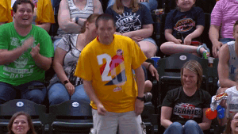
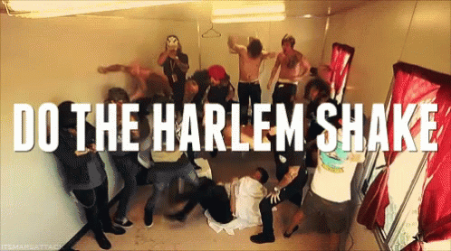
Video memes induce epidemic behavior
What’s the difference between pop culture and a meme?
“Do it for the vine” – some memes translate into physical dares meant to be recorded for the sake of virality, like dance moves or bizarre food challenges.

Slide 41
The musical.ly/tiktok era
Musical.ly and TikTok are both Chinese startup apps meant for video content creation.
Originally advertised for lip-syncing & includes pre-recorded musical and comedy audio clips
Has even more visual effects than Vine
Videos are considerably longer (up to 60 seconds)
Main attraction was the Duet feature to collaborate with other TikTokers

Slide 42
Viral tiktok examples
Kombucha girl
Sksksks VSCO girl
Mr. Sandman
Lizzo's biggest fan

Slide 43
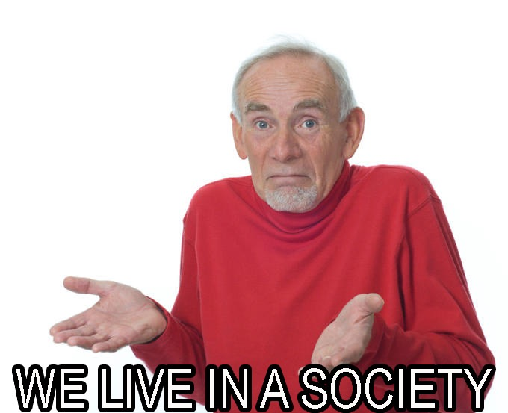
Meme propagation: viral marketing & political satire

Slide 44
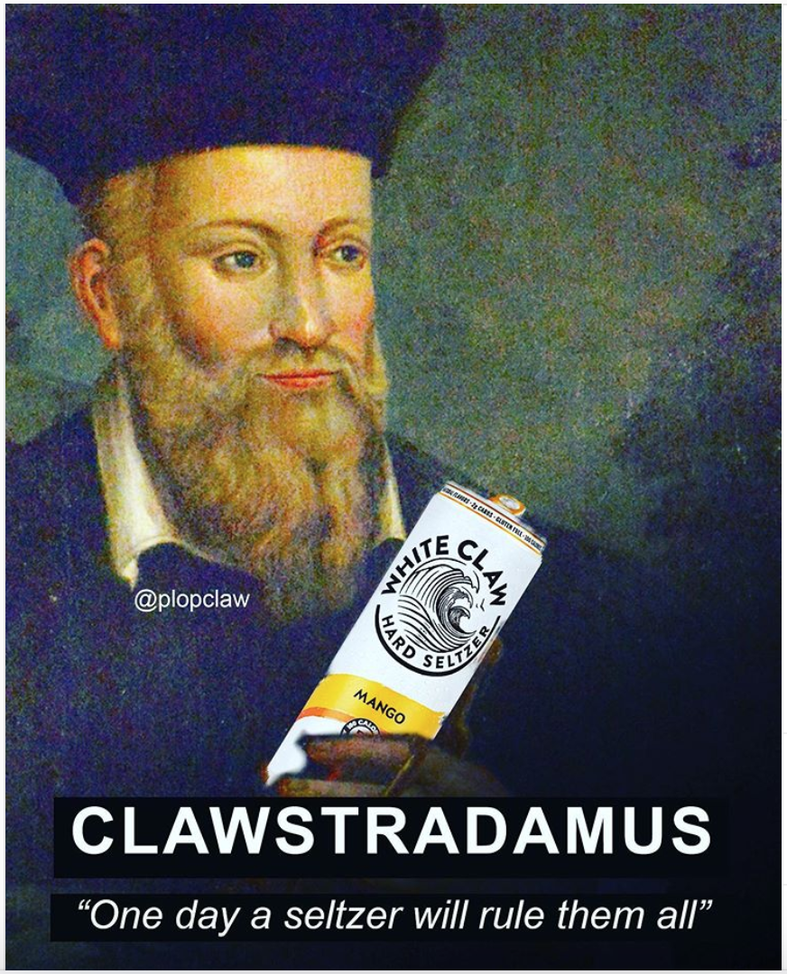
Viral advertising
Successful viral marketing is typically beyond the control of intentional marketing* from companies itself. Instead of branding through ads, products can go viral via memes or social media influencers** – this can lead to massive success in sales, as in the case of White Claw.
*”Contagious: Why Things Catch on” might be an interesting read
**We don’t have time to even touch the topic of influencers.
Notes:
STEPPS: social currency, triggers, emotion, public, practical value, stories

Slide 45
When “viral” advertising fails
Some people will disagree with me, but I HATE the trend of corporations pretending like they consist of one millennial intern running their marketing teams.
This phenomenon involves companies planting ads through various social media accounts, but they almost never capture the correct meme format – perhaps because by definition, memes should not contain inherent meaning.

Slide 46
When “viral” advertising fails

Slide 47
Memes as political commentary
Memes have more power than just humor: they can be used as satire, akin to a modern political cartoon.
Campaigns have also taken advantage of viral political advertising.
CHILLARY CLINTON

Slide 48
Memes as dystopian commentary
This part could be its own talk and I’m so sick of making slides. People cope with tense global relations and a dying Earth by making dark jokes.

Slide 49
Would you like to become a memer? Resources & more
See a meme you don’t recognize? Try Know Your Meme
Want to see hilarious astronomy-specific memes? Try Dank Matter Astrophysics Memes
Want a continuous stream of Gen-Z content, some of which is UT specific? Try UT Longmemes for Hornsy Teens

Slide 50
Where do memes go from here?
Will future memes have their own language altogether?
Will memes be created by bots?
Will we all turn into memes?
Notes:
Memes have transformed our lexicon & joke format

Slide 51
Bye.

